Slide 1
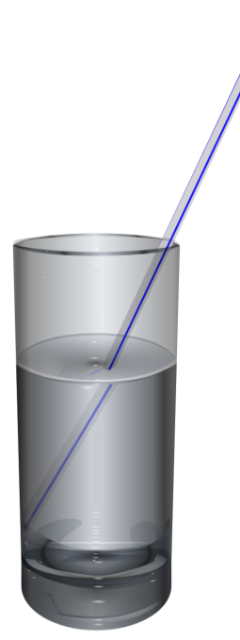
Tally Charts
Favourite Drinks
©All Things Maths www.allthingsmaths.co.uk

Slide 2
Are you ready to make your tally chart?
Drink | Tally
Soda
Orange juice
Smoothie
Hot Chocolate
Coffee
Water

Slide 6
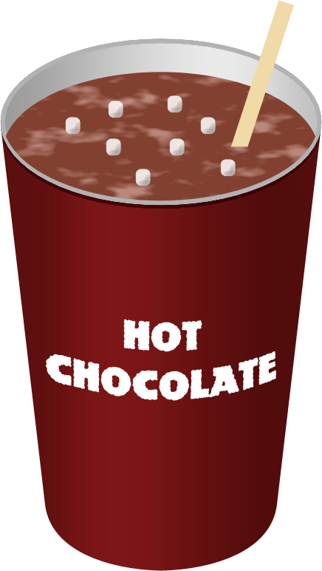

Slide 32
Let’s check your answers.

Slide 33
Drink | Tally
Soda | llll 4
Orange juice | llll l 6
Smoothie | llll ll 7
Hot Chocolate | llll 4
Coffee | lll 3
Water | llll 5

